Slide 1

Cocos Purchasing System
2
Druson - De Xing Liu/China/IBM
Mike - Zhi Ping K Kang/China/IBM
Aico - Wang Pei Pan/China/IBM

Slide 2
Agenda
Cocos System Briefing
Cocos System Show Time
Security
Q & A

Slide 3





Cocos Purchasing Briefing – 5 roles
Create / Update / Cancel an order
Admin
Buyer
Authorization & System Control
Cocos Purchasing System
Auditor
Audit orders
Manager
Approve / Reject the order
Supplier
Access / Accept the order

Slide 4
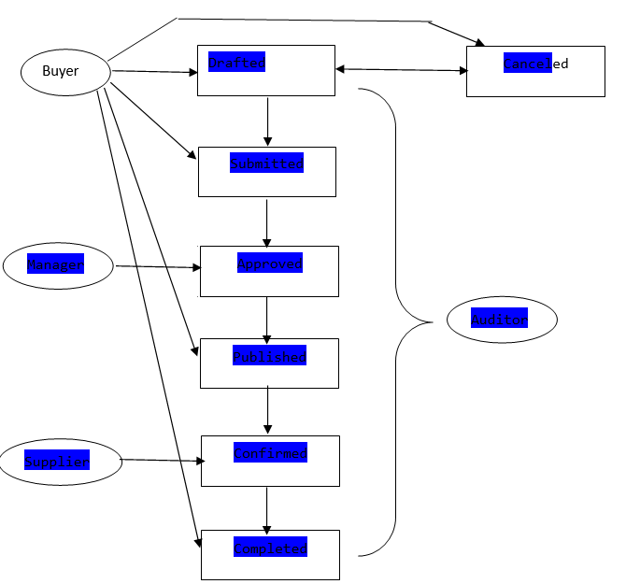
Cocos Purchasing Briefing – Business Flow
Reject

Slide 5
Cocos System Showing
Show Time…
Notes:
buyer@local.host
manager@local.host
supplier@local.host

Slide 6
Security
Technical Security
Business Security

Slide 7
Technical Security
1. CORS (Cross-Origin Resource Sharing) | Only allow access database locally. For ajax, not allow request from other server. | Completed
2. CSRF (Cross-site request forgery) | a) Use POST instead of GET for update request. | Completed
 | b)Use One-Time Token in the input request. | Completed
 | c) Enable cookie security. Not allow JavaScript access the cookie. | WIP
3. DDOS and ARP | No solution currently at application level. | WIP
4. Clickjacking | Enable the X-FRAME-OPTIONS header. | WIP
5. Content Security Policy | Enable Content-Security-Policy in HTTP header | WIP
6. TCP session / Socket Hijacking | No solution currently at application level. | WIP
7. Strict Transport Security | Forces usage of HTTPS | Completed
8. XSS (Cross-site scripting) | Validate any input of user, and strictly make all user input as a text. Every update request must input a captcha. | Completed
9. SQL inject | Use MySQL function to check the user input data. | Completed
10. Sniffing | Enable TLS. Force use HTTPS to transfer the data. | Completed
11. Session hijacking | Session and cookie expire immediately after user close the browser or logoff. | Completed
12. User maliciously attack | a) A high security level one time random number / char / jpg is needed during user registration | Completed
 | b) A high security level one time random number / char / jpg is needed during user login | WIP

Slide 8
Business Security
1.Data Exposure | a) Only registered user can access the system | Completed
 | b) Most advanced encrypted for system user login password (bcrypt) in database | Completed
 | c) Sensitive Data Encrypt in database | WIP
2.Login maliciously | Lock profile if inputting wrong password for 3 times, and send reminder email / SMS to specified user | WIP
3.Vendor Separation | Each vendor cannot see other vendors' info and cannot know which vendor is finally selected for an order | Completed

Slide 9
Business Security
4.Authorization Control | a) Only specified user (Buyer) can register system | WIP
 | b) Only registered buyer can login system to make / update / confirm an order | Completed
 | c) A buyer can only update / publish / confirm / cancel his own created orders | Completed
 | d) Only specified user (Manager) can register system | WIP
 | e) Only registered manager can login system to approve / reject an order and cannot update this order | Completed
 | f) Only the buyer's manager can login system to approve / reject the buyer's order | WIP
 | g) A manager can only see approved orders which approved by himself | Completed
 | h) Only specified user (Vendor) can register system, and this will be effective only after business admin authorize it | WIP
 | i) Only registered vendor can login system to accept / reject the order | Completed
 | j) Only specified vendor can see specified category order (for example, if buyer published an order for software, but some vendor only provide hardware, these vendors cannot see this order) | WIP
5.Order Control | a) Manager cannot approve / reject an order only until buyer submitted his order and cannot re-approve or reject this order after he approved it | Completed
 | b) Buyer cannot publish his order to Vendor only until got his manager's approval in system | Completed
 | c) Vendor can only accept / reject orders after buyer pubish them out | Completed
 | d) Buyer can only go on the orders after vendor confirm to accept | Completed
 | e) Buyer can cancel the order at any time even vendor accept the order, but he cannot cancel it if the order already completed | Completed

Slide 10
Business Security
6.Business Fraud (Buyer, manager or vendor order faking) | a) Business Auditor: Business auditor can see every order information, especially order initial price and final price, order quantity, existing inventory and so on. (But he has no authorization to submit / update / approve / cancel the order) | WIP
 | b) Business Audit: Store every transaction log, data analysis to find out exceptional order and send out monthly / yearly report, for example: -> A buyer always accept same vendor; -> A buyer accept a vendor even through his proposed price is much higher or much lower than other vendors; -> A buyer often submit a order while existing inventory is enough | WIP
7. Potential Security Issue / Attack | System Audit: system log to store each action, data analysis to dig security attack, high active user and so on | WIP
8.Data backup and disaster recovery | Backup data regularly, implement to cloud(i.e. Bluemix). | WIP

Slide 11

Thank you!

